Slide 1
Pylint
INGI 2252 : Software engineering : Mesures and maintenance
Code Checker for Python
Group 23
- Michaël Heraly - Thibault Gerondal
Professor: Kim Mens

Slide 2

Presentation of Pylint
Free open-source project written in Python

Slide 3
Features
Coding Standard
Error detection
Refactoring help
Fully customizable
Editor integration
IDE integration
UML diagrams
Continuous integration
Notes:
Coding Standard :
Checking line-code's length,
Checking if variable names are well-formed according to your coding standard
Checking if imported modules are used
Error detection :
Checking if declared interfaces are truly implemented
Checking if modules are imported
Refactoring Help :
Pylint detects duplicated code
Fully customizable :
pylintrc lets you customize which errors will be displayed.
Editor integration :
Run in emacs, vim, eclipse
IDE integration :
Pylint is integrated in various IDEs (spyder, editra, textmate, eclipse with pydev, etc.)
UML diagrams :
Pylint is shipped with pyreverse wich creates UML diagrams for python code.
Continuous integration :
possible with Apycot, hudson or jenkins

Slide 4
How PyLint works

Slide 5
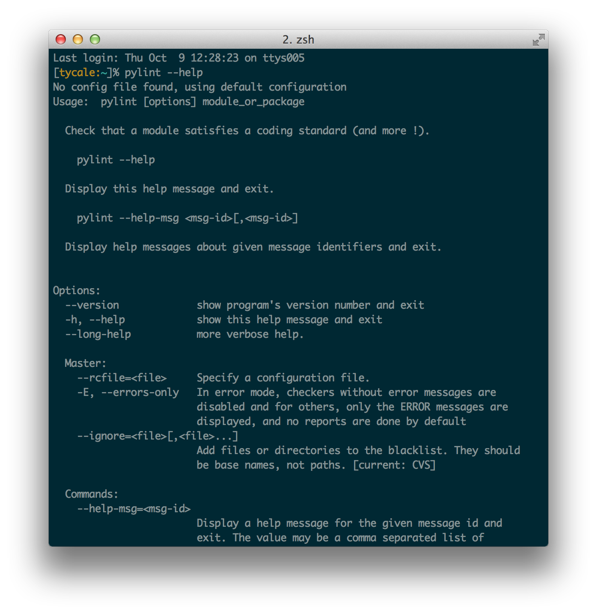
Let’s discover Pylint
First, let’s check the options that Pylint offers :
--rcfile : configuration file
--generate-rcfile : generate a default configuration file
-f : output format
Text
Parseable
Colorized
msvs (visual studio)
HTML
-r : display full report
(Y or N)
Notes:
We’ve decied to show only interesting options in our point of view.
This list is not exhaustive.
The first thing we can see is that we’re able to give a configuration file to PyLint. So we did ask ourself « what can we put on that file ? ».
Few lines further on the help section, we discovered an argument to generate a configuration file. We’re going to analyse this file later on the slides.
The format option (-f) looks wonderful since we can export the results in different format. Since there is a « parseable format », we’ll be able to parse and process the output of PyLint easily.
If the report option is on « y », we have more informations : statistics on package and statistics on type of errors.

Slide 6
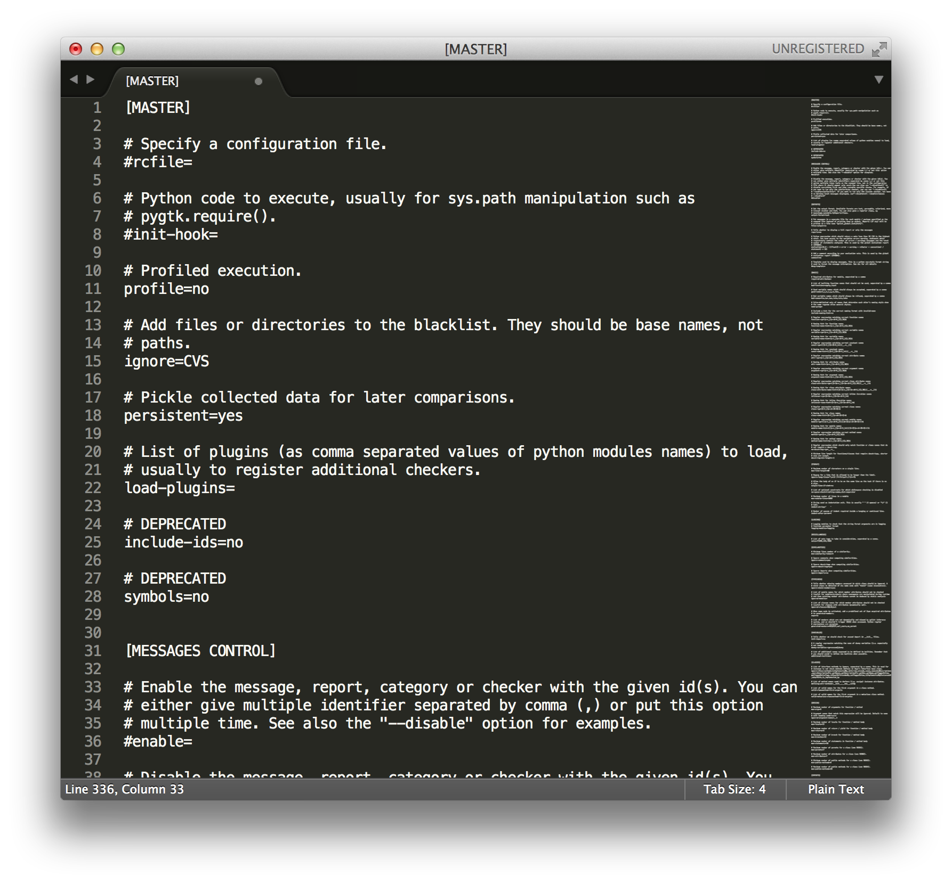
PyLint configuration file
Different sections :
MASTER
MESSAGES CONTROL
REPORTS
BASIC
FORMAT
LOGGING
SIMILARITIES
TYPECHECK
VARIABLES
CLASSES
DESIGN
IMPORTS
EXCEPTIONS
Notes:
The default PyLint configuration file is nicely commented. So, it’s clear and readable. We can see all options available with PyLint from this file.
Let’s take a closer look at some interesting sections.

Slide 7
PyLint configuration file : BASIC Section
good-names : List of variable names which should always be accepted
bad-names : List of variable names which should always be refused
*-rgx : Regular expressions matching correct name for functions, variables, constants, attributes, arguments, classes, inline iteration, modules and methods
Notes:
Here are some examples of options in the BASIC section of PyLint configuration file.
Basic section is a lot about naming conventions.

Slide 8
PyLint configuration file : FORMAT Section
max-line-length : Maximum number of characters on a single line
max-module-lines : Maximim number of lines in a module
ident-string : String used as identation unit.
Notes:
Here are some examples of options in the FORMAT section of PyLint configuration file.
In this section, we can define good practice we want to use about the formatting.
The PEP8, Style Guide for Python Code, is respected by default. The PEP 8 is considered like a reference for most Python developer.

Slide 9
PyLint configuration file : TYPECHECK Section
ignore-mixin-members : Tells whether missing members accessed in mixin class should be ignored
ignored-modules : Module names for which member attributes should not be checked
ignored-classes : Classes names for which member attributes should not be checked
Notes:
Here are some examples of options in the TYPECHECK section of PyLint configuration file.
This section allows us to ignore modules and classes. This can be useful if want to restrict our analysis.
We can see that PyLint can handle complex structures like mixin class but we need to tell him (for exemple, for the mixin class, PyLint detects if its name ends with "mixin" (case insensitive)).

Slide 10
PyLint configuration file : DESIGN Section
max-args : Maximum number of arguments for function and method
ignored-argument-names : Argument names that match this expression will be ignored
max-locals : Number of locals for function and method body
max-returns, max-branch, max-statements, max-parents, max-attributes, min-public-methods, max-public-methods : Maximum (or minimum) for aforementioned properties
Notes:
Here are some examples of options in the DESIGN section of PyLint configuration file.
These options let us the possibility to refine the kind of situations PyLint should consider as appropriate or not.
We’ve decided to show some possible options of PyLint.. There is quite more available options.
In conclusion, PyLint give us great opportunities to adjust the tool to the needs of a Python project.

Slide 11
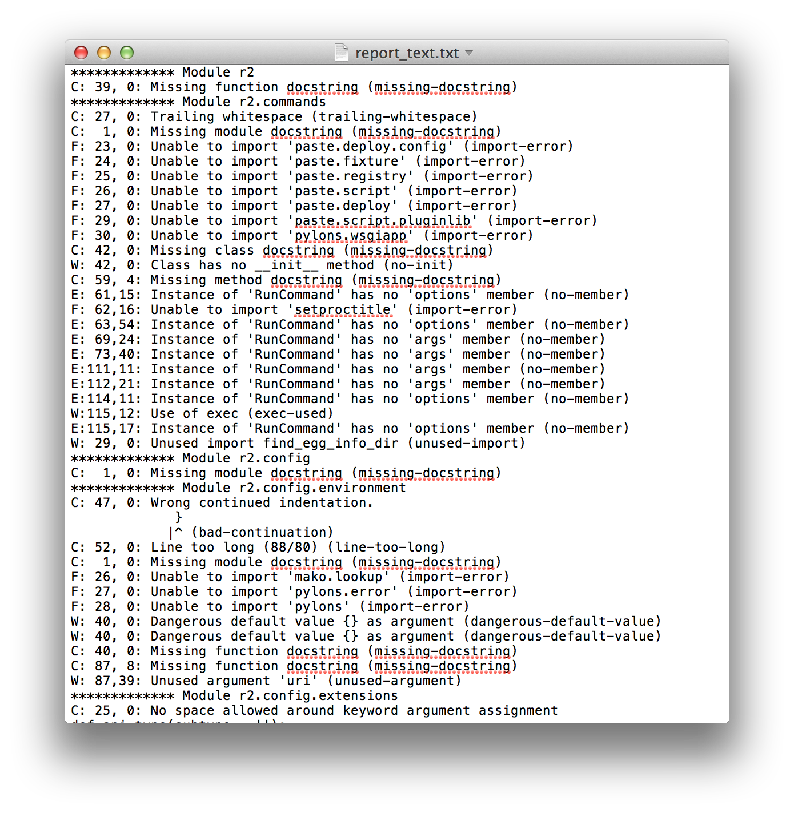
Pylint Reports : Text
Notes:
We ran PyLint on reddit.
This is the the text report generated.

Slide 12
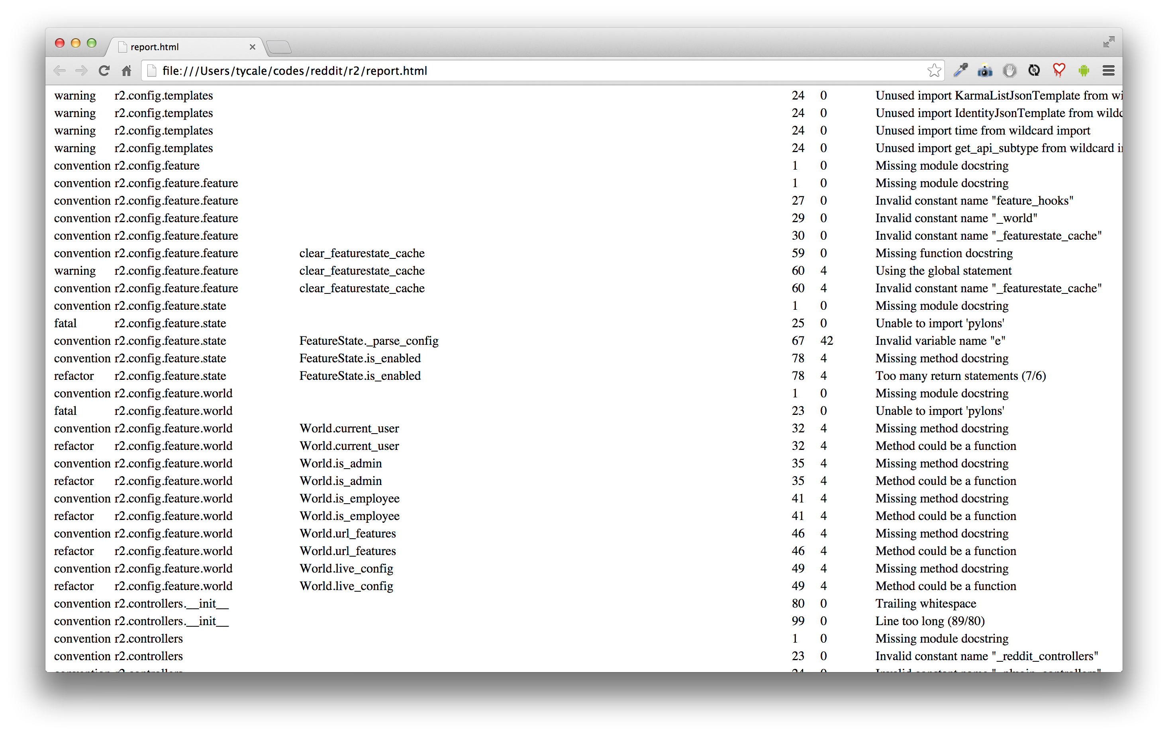
Pylint Reports : HTML
Notes:
Just a view of the HTML report.

Slide 13
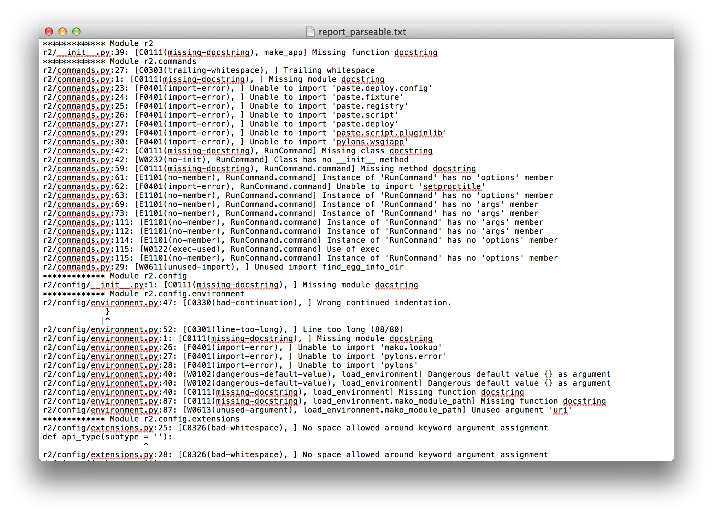
Pylint Reports : Parseable format
Notes:
Just a view of the Parseable format report.

Slide 14
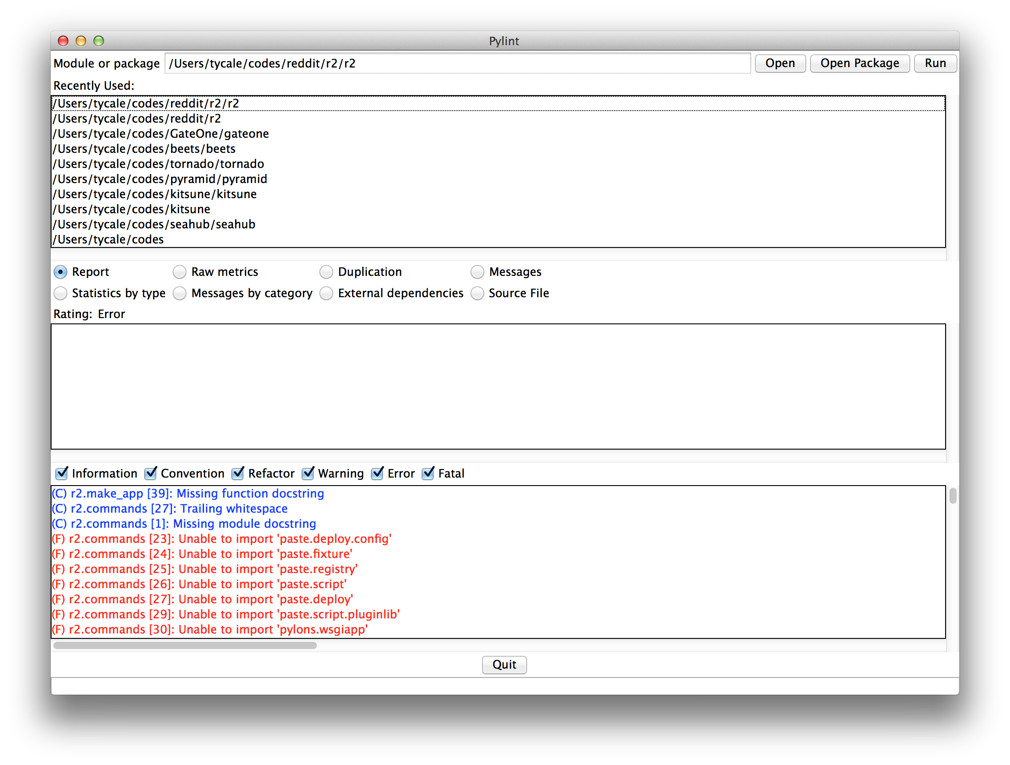
Pylint-GUI : A Graphical User Interface
Notes:
PyLint comes with a Graphical User Interface.
In this case, it’s quite not easy to use cause of the number of errors to display.

Slide 15
Code checks and code improvements suggestions by Pylint

Slide 16
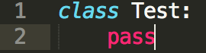
Let's do a test
We created an empty class in python
The report of Pylint :
C: 2, 0: Final newline missing (missing-final-newline)
W: 2, 0: Found indentation with tabs instead of spaces (mixed-indentation)
C: 1, 0: Missing module docstring (missing-docstring)
C: 1, 0: Missing class docstring (missing-docstring)
C: 1, 0: Old-style class defined. (old-style-class)
W: 1, 0: Class has no __init__ method (no-init)
R: 1, 0: Too few public methods (0/2) (too-few-public-methods)
Notes:
We can see that there is a lot of kind of errors. A lot of noise for only two poors lines. But it's absolutely fine since this code make no sense at all.
We can see the kind of messages (critics) Pylint give to us.

Slide 17
Analyse of the output
We can see that Pylint does give us a lot of output. There is different kind of "critics" :
C : Convention
R : Refactor
W : Warning
E : Error
The line of the critic is the first number. There is a 'tag' (eg. 'no-init') for identifying each 'critic'
C: 2, 0: Final newline missing (missing-final-newline)
W: 2, 0: Found indentation with tabs instead of spaces (mixed-indentation)
C: 1, 0: Missing module docstring (missing-docstring)
C: 1, 0: Missing class docstring (missing-docstring)
C: 1, 0: Old-style class defined. (old-style-class)
W: 1, 0: Class has no __init__ method (no-init)
R: 1, 0: Too few public methods (0/2) (too-few-public-methods)
Notes:
There is four kind of critics given by Pylint.
Convention is about convention..
Refactor is advice for gaining lines of code.
Warning is when things looks really strange.
Error is when something should not work at all.

Slide 18
Pharo Vs. Pylint
We did summarise some critic that Pharo detected and if Pylint was able to detect them in the following table :
Critic on Pharo | Critic on Pylint
Class not referenced | Not detected
Class variable capitalization | Detected: old-style-class
Defines = but not hash | Not detected
Excessive number of methods | Detected: min-public-methods and max-public-methods
Excessive number of variables | Detected : max-locals
No class comment | Detected: missing-docstring
Notes:
We did use the following python code for this comparison :
class this_class_is_not_referenced:
def __init__(self):
self.useless_var = 42
def dafuq(self):
return "dafuq"
class song_genre:
def __init__(self, name):
self.name = name
def do_what_u_want(self):
abstract
def get_name(self):
return self.name
def set_name(self, name):
hello = name
self.name = name
class electro(song_genre):
def __init__(self):
super().__init__("electro")
def dis(self, useless_arg):
print(self.name)
def stat_m():
return "static_method"
def m1(self):
electro.stat_m()
def m2(self):
a
def m3(self):
a
def m4(self):
a
def m5(self):
a
def m6(self):
a
def m7(self):
a
def m8(self):
a
def m9(self):
a
def m10(self):
a
def m11(self):
a
def __eq__(self, other):
return "a" == "b"
print("Useless program")
elec = electro()
elec.dis("wtf")
elec2 = electro()
print(elec == elec2)

Slide 19
Analysis (1)
Pylint does find other kind of critics :
Use of super on an old style class (super-on-old-class)
Methods that don't use instance variables ["Method could be a function" (no-self-use)]
Statements that do nothing ["Statement seems to have no effect (pointless-statement)"]
Unused variable 'hello' (unused-variable)
Notes:
Since Smalltalk and Python are quite different language, we can't do that much comparaisons between them.
Here some other critics givent by Pylint during our test.
The description given by Pylint are quite easy to read an understand

Slide 20
Analysis (2)
Pylint does find other kind of critics :
Undefined variable 'a' (undefined-variable)
Unused argument 'useless_arg' (unused-argument)
Invalid method name "m1" (invalid-name)
Invalid constant name "elec" (invalid-name)
We found one false-positive :
[Undefined variable 'abstract' (undefined-variable)]
Notes:
The description given by Pylint are quite easy to read an understand.
We also had a false-positive. For doing abstract class in python, some developer are used to write "abstract" in the core of the method since there was no way to indicate that a method was abstract since python 2.6 (with abc).
So, it's not a real false-positive.. And if we want to avoid this critic, we can add this keyword in the pylintrc.

Slide 21
Analysis (3)
Some detections of pylint are somehow "correlated", for exemple :
E: 36, 4: Method has no argument (no-method-argument)
R: 36, 4: Method could be a function (no-self-use)
for the line 36 (in class method ) :
def stat_m():
return "static_method"
Notes:
Some critics can come by two in certain cases. We should run Pylint on a bigger project and analyse all statement for each line to see if these two critics are really correlated.
But, we think they could be somehow correlated.

Slide 22
Critiques on Individual Critics
Pylint is fully customizable, as said before. So if a critic is too restrictive, we can always adjust. For example :
invalid-name : we can define a regex in the pylintrc file to clarify what a good name : variable-rgx=[a-z_][a-z0-9_]{2,30}$
line-too-long: Again, we can change that in Pylintrc : max-line-length=80
Notes:
The fact that pylint is fully customizable is a great advantage. We can adjust nearly everything if we find something too restrictive or not enough. It's quite hard to criticize critics when you can change all the settings to match what you want.
If a critic is not revelent in a project, we can even mute it.

